Slide 1
UNCC & Daimler Challenge
Truck Manufacturing Plant Visualization Challenge

Slide 2
Why Are We Here
Challenge:
Visualize Real Time Production Metrics
Tracking Vehicles down the line
Key Performance Indicators of Process
Why:
Faster Informed Decision Making
Know where to focus attention

Slide 3
Why Are We Here
Below are some questions to help paint the view of what each role might be looking for in a tool that you are to make.
Supervisor: (More local view specific to their area of responsibility)
How is my shift operating? Are there shortages that I need to be aware of?
Manager:
How is my department performing over all? Is there a specific shift that is having challenges in shortages or cries? How many trucks has my department completed in the past hour?
Plant Director:
How is the plant performing? Is there a team at the plant that I need to help or send help to? Is there an area in the plant that is experiencing a lot of slow down?
The plant is moving to 100% direct runs, trucks with no issues. How can a new visualization tool help us get there?

Slide 4
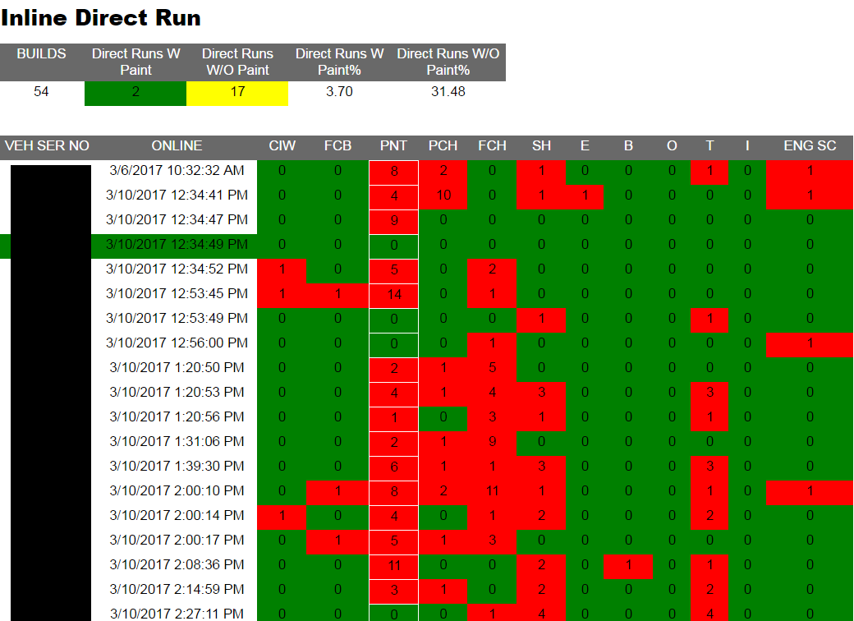
Current Systems: Inline Direct Run

Slide 5
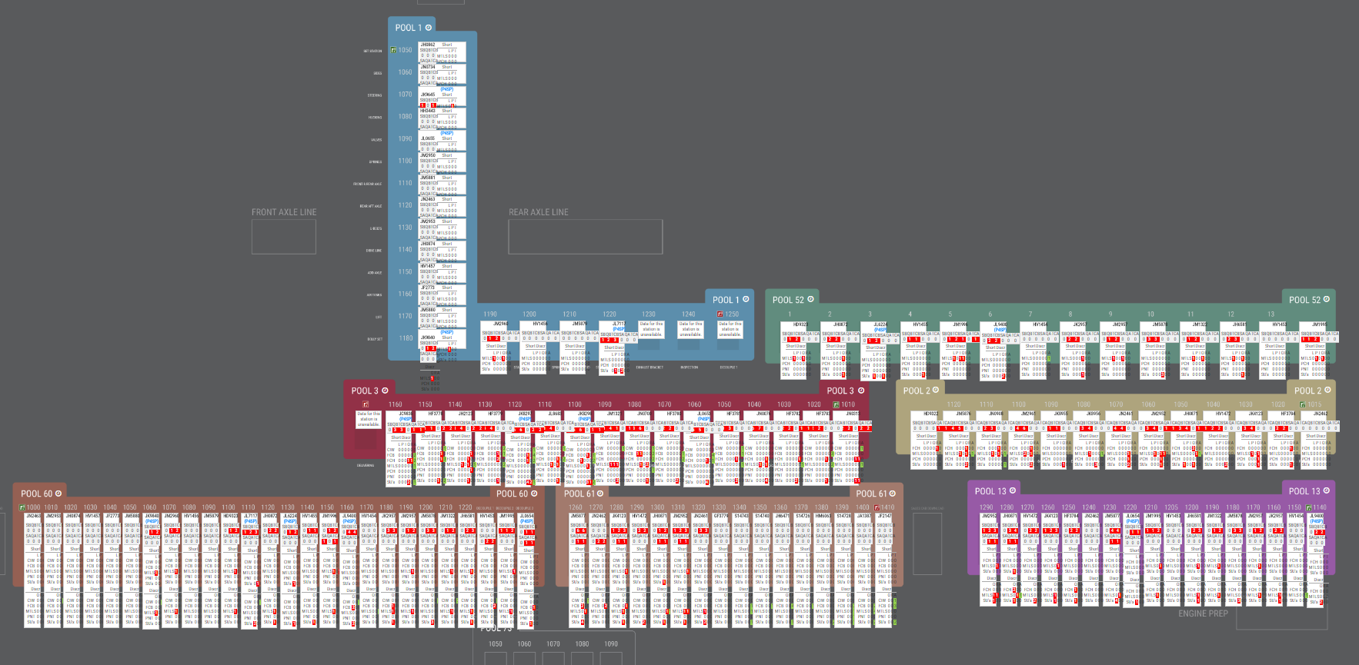
Assembly Line Tracker

Slide 6
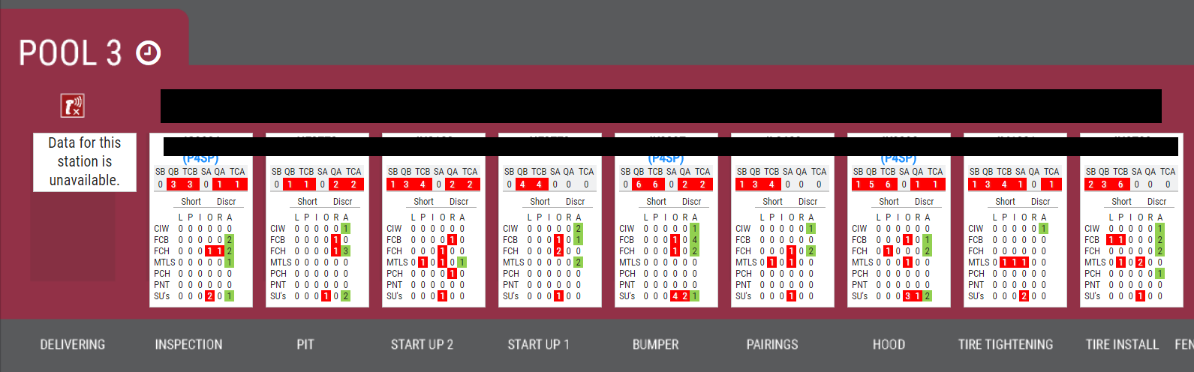
Assembly Line Tracker
Zoomed in view of the assembly line tracker.
Challenges with this tool:
Have to scroll around the entire screen to get an idea how the plant is operating, if your department is has cris that have been found in other departments.
Tiny text.

Slide 7
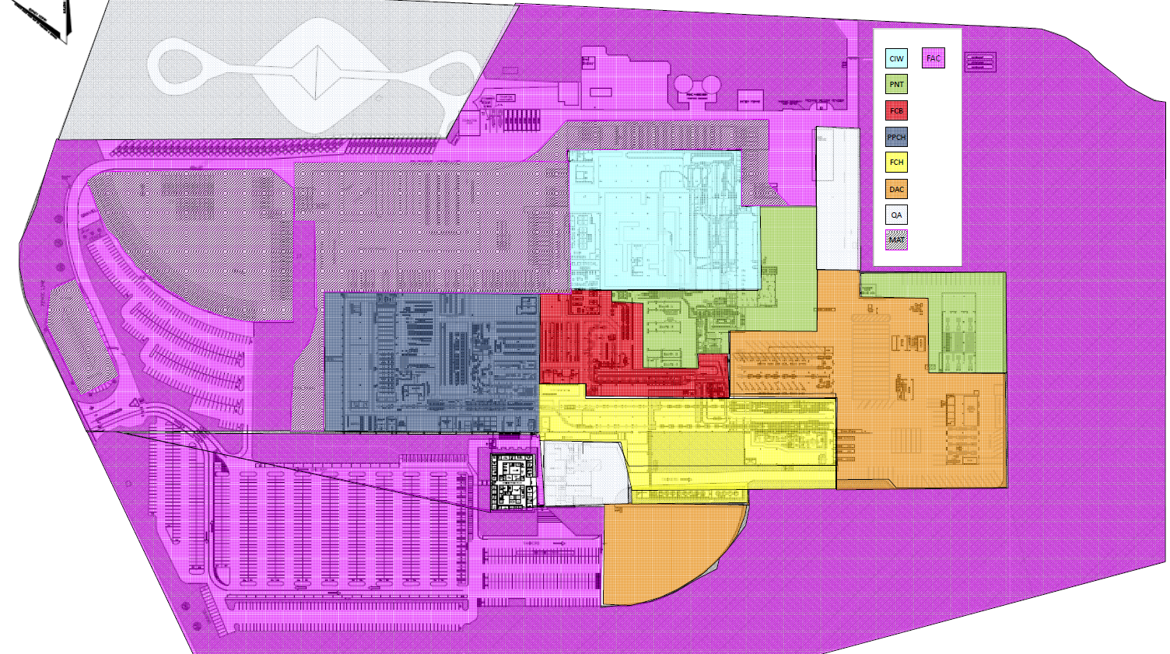
opr_name
Chassis Start (PCH)
Rear U-Bolt (PCH)
Top Station (FCB)
Cab Upload 2 (FCB)
M2 Deck Start (CIW)
PAINT (PNT)
Enter Offline (OFF)
CIW upload (CIW)
A Line (FCH)
Cab Upload (FCB)
B Line (FCH)
Pool 60 Start (FCB)
Pool 13 Start (ENG)
Sold
Front U-Bolt (PCH)
Hood Upload (FCB)
C1
C2
B5
B6
B1
B1
B3
C4
B2
B2
C3-A
B6
C3-B
C1
B4
B5
B3
E1
B4
C5
C2
E1
H1
C2
B6
H1
C3-B
C4
C3-A
C5

Slide 8
Data
Data has been randomized
Data has been cleaned
This data belongs to Daimler Trucks North America and can not be used for research outside of the UNCC’s Visualization class Fall Semester 2017.

Slide 9
Data: Tracking Challenges
Cries On The Line
QA inputs cri’s into STVMS. Based on where the cri is put in will determined the FOUND_INSP_TEAM. 107 = CIW (1), Shift (0), Area (7). Generally, shift 0 =‘s 1st shift.
ISNP = inspector/QA
RESP_INSP_TEAM = If QA has identified a cri that belongs to one department, but works in another, a department code will be assigned here.

Slide 10


Data: Tracking Challenges
Item Short
Table that tracks if a part is not available for installation.
Paint Tracking
Table that tracks paint defects on a cab.
REPAINT_REQ = if the issue requires significant amount of work
* Short Type Code
B=In Building, Not On Truck
T=W/Truck
O=Offline
I= Installed
E=Not Received

Slide 11

Data: Location
opr_name
Chassis Start
Rear U-Bolt
Top Station
Cab Upload 2
M2 Deck Start
PAINT
Enter Offline
CIW upload
A Line
Cab Upload
B Line
Pool 60 Start
Pool 13 Start
Sold
Front U-Bolt
Hood Upload
STVMS is a data input tool used at the plants. Everything from cries/bugs,
material shortages, to engineering calls utilize STVMS to capture this data.

Slide 12
opr_name
Chassis Start (PCH)
Rear U-Bolt (PCH)
Top Station (FCB)
Cab Upload 2 (FCB)
M2 Deck Start (CIW)
PAINT (PNT)
Enter Offline (OFF)
CIW upload (CIW)
A Line (FCH)
Cab Upload (FCB)
B Line (FCH)
Pool 60 Start (FCB)
Pool 13 Start (ENG)
Sold
Front U-Bolt (PCH)
Hood Upload (FCB)
Department | Abbreviation | 3 Number Code
Pre-paint Chassis | PCH | 400
Final Cab | FCB | 200
Paint | PNT | 300
Final Chassis | FCH | 500
Cab In White | CIW | 100
Offline | OFF | 600
Materials | MTL | 800
PDI | PDI | 700
Engine Line is part of PCH
Hood Assembly is part of FCB

